Slide 1
English Language Programs
September 2023

Slide 2
ASU English Language Program
General Information

Slide 3

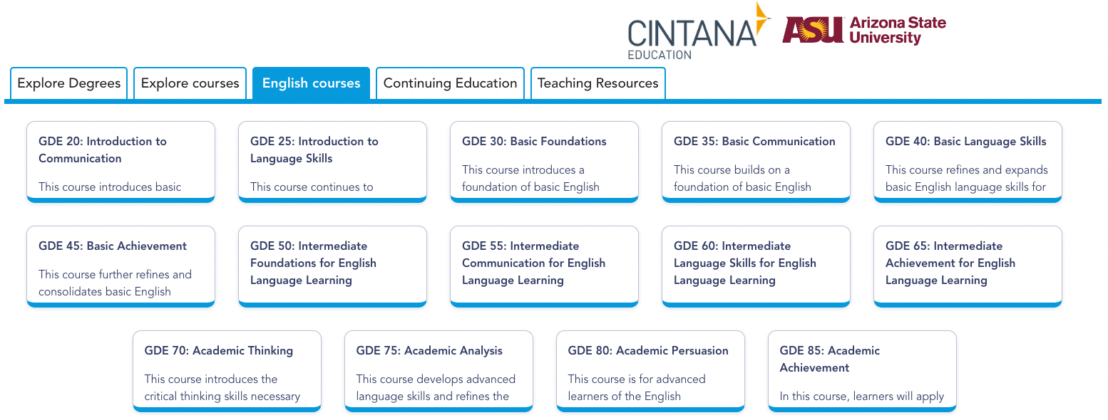
ASU English Language Program
Members of the Cintana Alliance have access to a comprehensive and innovative English language training program, including ASU Global Launch online courses and Cintana’s social/cultural immersion program.

Slide 4
Overall Benefits
Courses can be offered face-to-face, fully online or blended
Comprehensive content with no 3rd party textbooks and workbooks
Adaptable learning paths can be designed to fit institutional needs: immersions, regular in-curriculum or extracurricular programs
Quality and learning outcomes monitoring for continuous improvement
Ensure a solid CEFR B2 English level and academic English readiness for selected tracks, leading to successful ASU coordinated programs

Slide 5
ASU Global Digital English
ASU Global Launch provides online English and academic skills courses featuring high-quality content that is innovative, fun and challenging. These courses provide a robust curriculum from Global Launch’s top-quality educators and allow learners to work at their own pace from anywhere in the world.
General English courses: for basic through high-intermediate learners (CEFR A2–B2).
Academic English courses: for high-intermediate through advanced learners (CEFR B2–C2).
14 courses, ranging from pre-zero beginner to advanced level, and covering the four core skills: reading, writing, listening, and speaking.

Slide 6

Professional English
Developed by Cintana, with ASU and original content, Professional English is a practical, hands-on course that teaches students how to present themselves and how to communicate more effectively in a professional environment. Along 8 modules students are introduced to personal branding, email writing, short proposal writing, non-verbal and oral communicating and delivering an effective presentation.
Students will be ready to face their career and have the communication tools needed to become successful professionals.
Watch the intro video

Slide 7


ASU GLOBAL DIGITAL ENGLISH
COURSE ROADMAP
CEFR A0 to A1
CEFR A1 to B1
CEFR B1 to C1
Cumulative Hours
Track 1 – General English: 800 Hours
Track 2 – Academic English: 880 Hours
160 Hours
480 Hours
560 Hours
Pre-Basic
Basic
Intermediate to Advanced
GDE 20: Introduction to Communication
GDE 25: Introduction to Language Skills
GDE 50: Intermediate Foundations
GDE 30: Basic Foundations
GDE 35: Basic Communication
GDE 40: Basic Language Skills
GDE 45: Basic Achievement
General English
B1 to C1
GDE 55: Intermediate Communication
GDE 60: Intermediate Language Skills
GDE 65: Intermediate Achievement
Track 1
80 Hours Classroom
80 Hours Self-guided Learning
160 Hours Classroom
160 Hours Self-guided Learning
40 Hours Classroom
40 Hours Self-guided Learning
120 Hours Classroom
120 Hours Self-guided Learning
Academic English
B1 to C1+
GDE 70: Academic Thinking
GDE 75: Academic Analysis
GDE 80: Academic Persuasion
GDE 85: Academic Achievement
Track 2
Recommended Total number of hours per course:
Classroom Hours: 40 hours
Self-guided: 40 hours
160 Hours Classroom
160 Hours Self-guided Learning

Slide 8
Level | Entry Level | Course | Exit Level | Classroom Hours | Self-guided Hours | Total Guided Hours | Cumulative Hours
Pre-Basic | A0 | GDE 20: Introduction to Communication | A1- | 40 | 40 | 80 | 80
Pre-Basic | A1- | GDE 25: Introduction to Language Skills | A1 | 40 | 40 | 80 | 160
Basic | A1 | GDE 30: Basic Foundations | A2- | 40 | 40 | 80 | 240
Basic | A2- | GDE 35: Basic Communication | A2 | 40 | 40 | 80 | 320
Basic | A2 | GDE 40: Basic Language Skills | B1- | 40 | 40 | 80 | 400
Basic | B1- | GDE 45: Basic Achievement | B1 | 40 | 40 | 80 | 480
Intermediate | B1 | GDE 50: Intermediate Foundations | B1+ | 40 | 40 | 80 | 560
Intermediate | B1+ | GDE 55: Intermediate Communication | B2 | 40 | 40 | 80 | 640
Intermediate | B2 | GDE 60: Intermediate Language Skills | B2+ | 40 | 40 | 80 | 720
Intermediate | B2+ | GDE 65: Intermediate Achievement | C1 | 40 | 40 | 80 | 800
Academic English | B1+ | GDE 70: Academic Thinking | B2 | 40 | 40 | 80 | 640
Academic English | B2 | GDE 75: Academic Analysis | B2+ | 40 | 40 | 80 | 720
Academic English | B2+ | GDE 80: Academic Persuasion | C1 | 40 | 40 | 80 | 800
Academic English | C1 | GDE 85: Academic Achievement | C1+ | 40 | 40 | 80 | 880

Slide 9
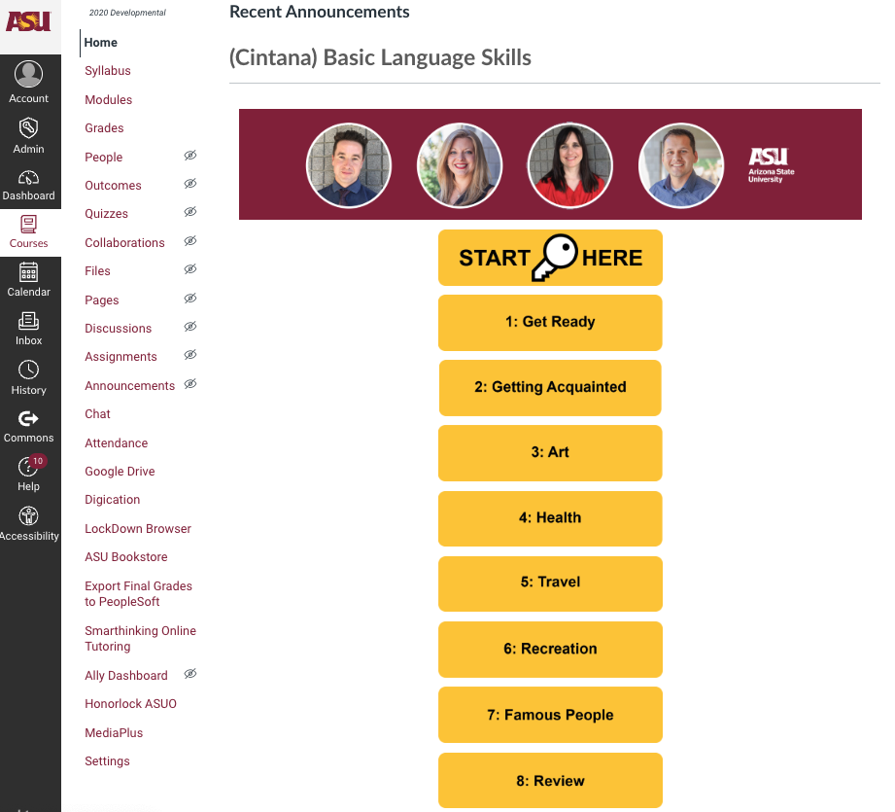
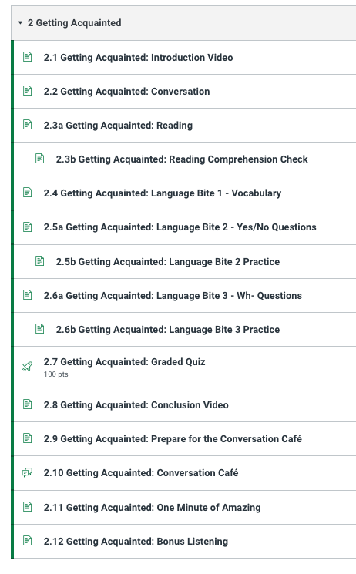
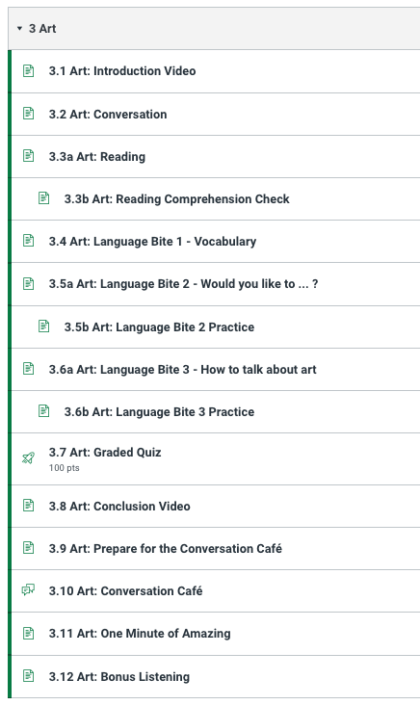
Inside the course - GDE 40: Basic Language Skills

Slide 10
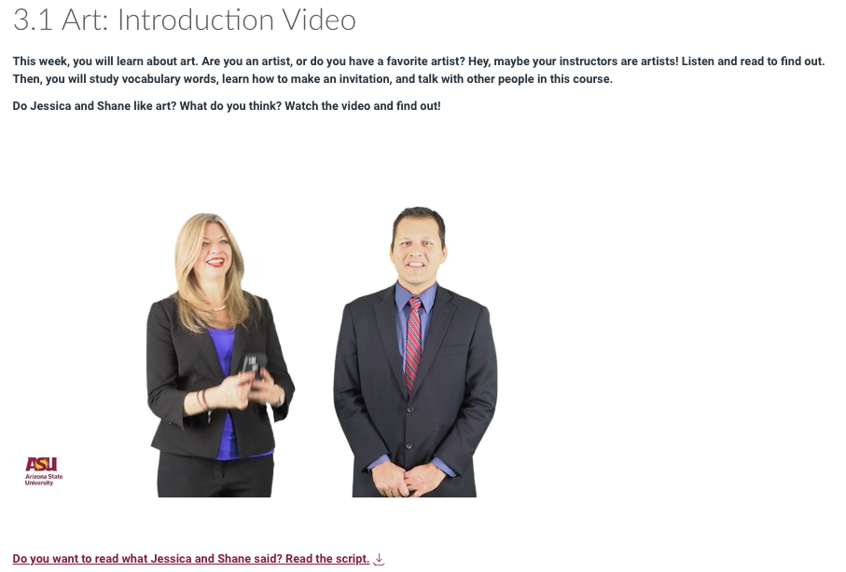
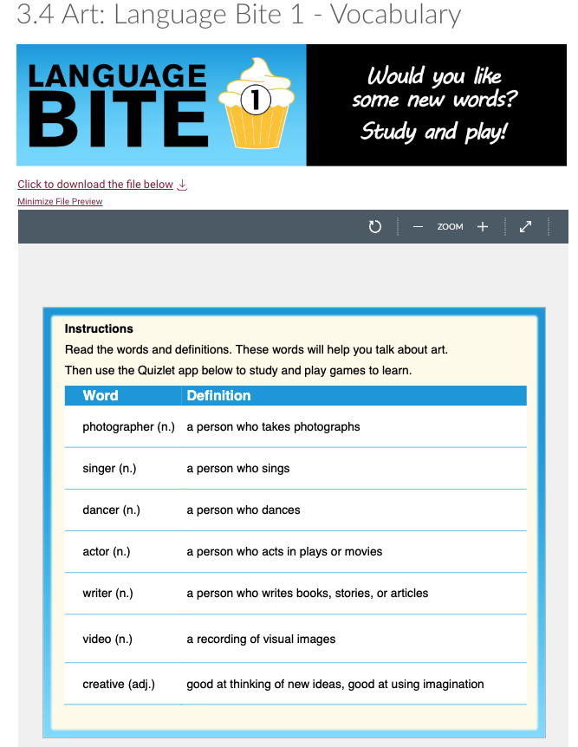
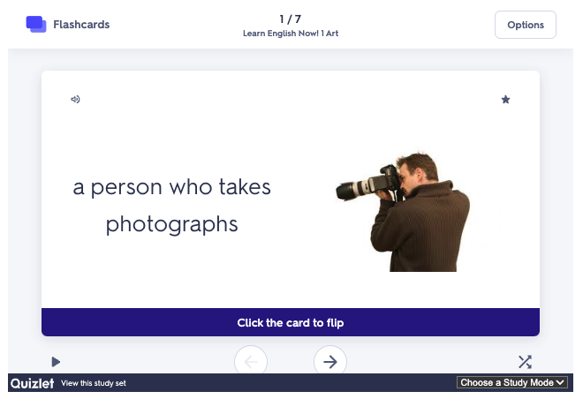
Inside the course - GDE 40: Basic Language Skills

Slide 11
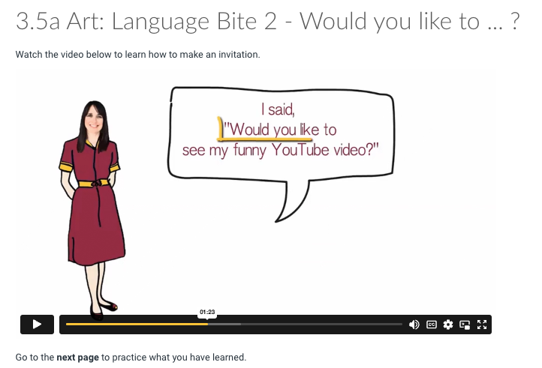

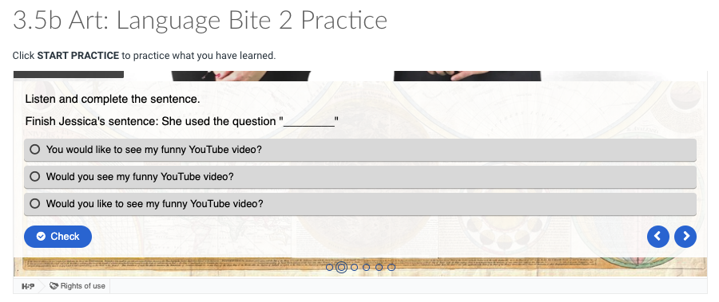
Inside the course - GDE 40: Basic Language Skills

Slide 12
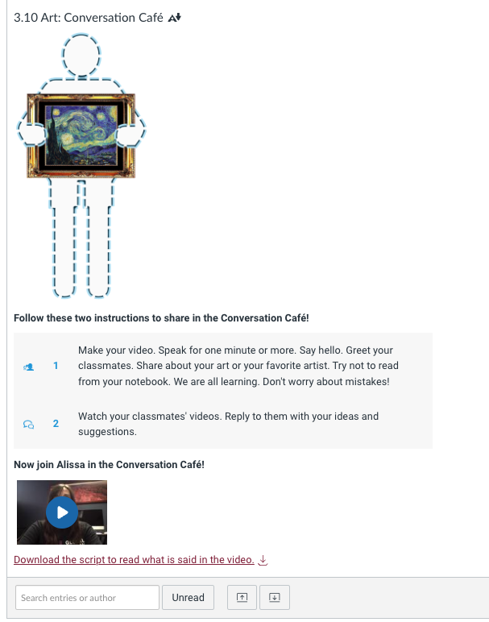
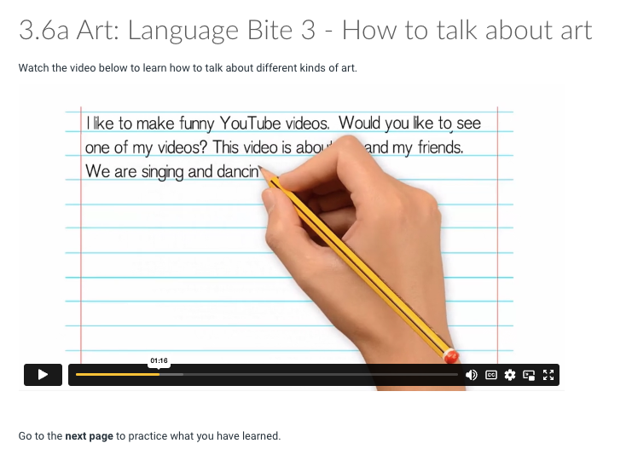
Inside the course - GDE 40: Basic Language Skills

Slide 13
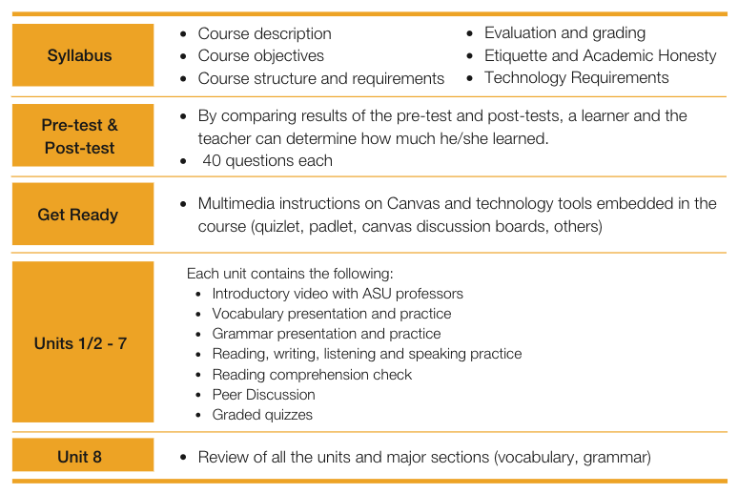
Inside the course
Notes:
Learning outcomes established and measured at unit and course level
Students must complete each course before progressing to the next
Courses can be customized an integrated with existing curricula
Courses can be customized to require students to complete each unit before progressing to the next
Four skills knowledge and practice
Automatic correction for practice exercises and quizzes
Discussions for peer interaction (moderation can be established by institution, if desired)
Pre-zero courses (GDE 20 and GDE 25) have a version with course instructions in Spanish
All other courses are fully in English
Note: This is a general outline. A few courses may differ slightly.

Slide 14
Suggested Implementation Models

Slide 15
Implementation Models
Fully online, self-paced
Placement Test
Required. Available options: current test at the ACI, VTEST, EduSynch or Extempore
Learning Design
ASU Global Digital English courses offered 100% asynchronously
Cultural/social immersions may be offered as additional learning opportunities
LMS
Courses are available as Canvas course packages and can be uploaded to ACI LMS. A few courses are available as Moodle packages. Courses can be fully customized by ACI.
Instructors
Courses are fully self-paced and do not require instructors
Admin Support
Administrative support is needed for placement tests and academic operations (i.e., course setup, student enrollment, certificate issuance, technical support etc.)
Student Success
A tutor or success coach is recommended to monitor student engagement, motivate students, send communications, and be a point of contact for student support

Slide 16
Implementation Models
Hybrid / Blended
Placement Test
Required. Available options: current test at the ACI, VTEST, EduSynch or Extempore
Learning Design
ASU Global Digital English courses + Professional English offered asynchronously
Synchronous sessions offered online and/or face-to-face, aligned with course content
Cultural/social immersions may be offered as extracurricular learning opportunities
LMS
Courses are available as Canvas course packages and can be uploaded to ACI LMS. A few courses are available as Moodle packages. Courses can be fully customized by ACI.
Instructors
Instructors are required to conduct synchronous sessions (for all courses) and for grading (Professional English course only)
Admin Support
Administrative support is needed for placement tests and academic operations
Student Success
A tutor or success coach is recommended to monitor student engagement, motivate students, send communications, and be a point of contact for student support

Slide 17
Implementation Models
Face-to-Face
Placement Test
Required. Available options: current test at the ACI, VTEST, EduSynch or Extempore
Learning Design
Regular face-to-face sessions offered aligned with course content
ASU Global Digital English courses + Professional English offered as asynchronous support
Cultural/social immersions may be offered as extracurricular learning opportunities
LMS
Courses are available as Canvas course packages and can be uploaded to ACI LMS. A few courses are available as Moodle packages. Courses can be fully customized by ACI.
Instructors
Instructors are required to conduct face-to-face classes and for grading (online grading needed for Professional English course only)
Admin Support
Administrative support is needed for placement tests and academic operations
Student Success
The face-to-face instructor is responsible for monitoring student engagement, motivating students, sending communications, and being a point of contact for student support

Slide 18
Placement Tests available for ACIs

Slide 19
Cintana Placement Test

Slide 20

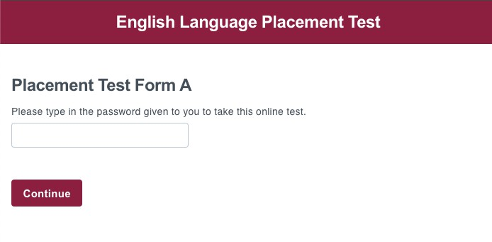
Cintana Placement Test
Fully online, responsive.
Test results are mapped to CEFR.
Developed by leading experts in the field.
Students access the testing environment through a secure platform.
Test is administered by Cintana.
Free of charge for ACI.
Certificate/Test report issued can have the ACI logo.
Listening and Reading skills are measured.
60 questions test, 25 Listening questions and 35 Reading questions.
3 forms available.
60 mins test.

Slide 21
Reading
Listening

Slide 22
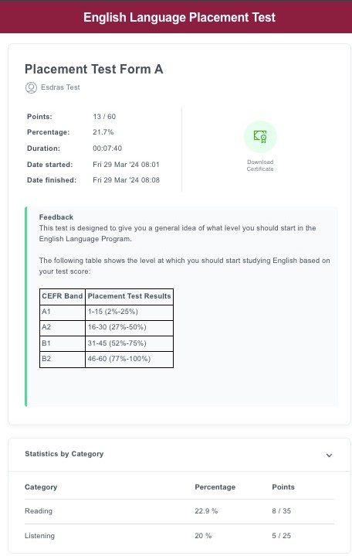
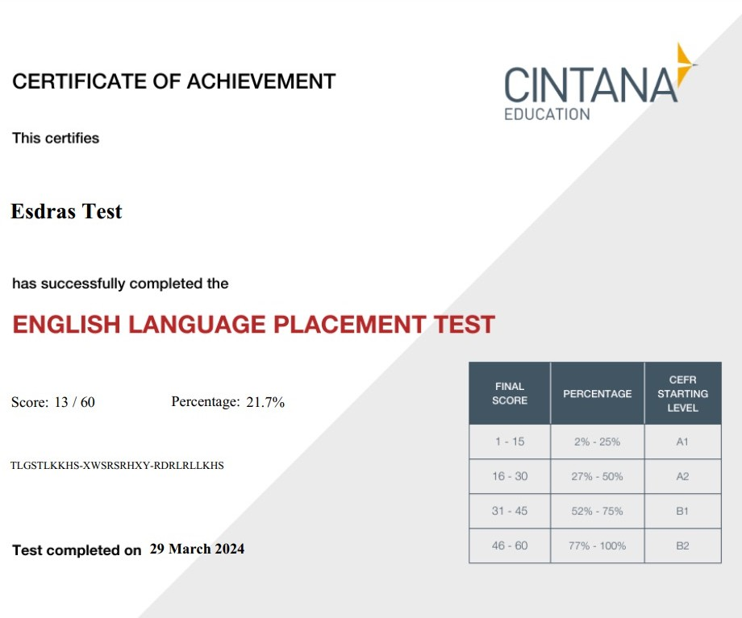
Results and Certificate
User

Slide 23
VTEST / Burlington English

Slide 24

VTEST
Adaptive test, fully online, responsive
Test results are mapped to CEFR
Tests validated for reliability and efficacy
Students access the testing environment through a secure identification code
Full admin dashboard available for the ACI
License management can be done by ACI or VTEST
Licenses can be purchased by ACI or individually by prospects, students, faculty or staff
Certificate/Test report issued can have the ACI logo
Access the VTEST User Manual
Access the flyer in Spanish

Slide 25
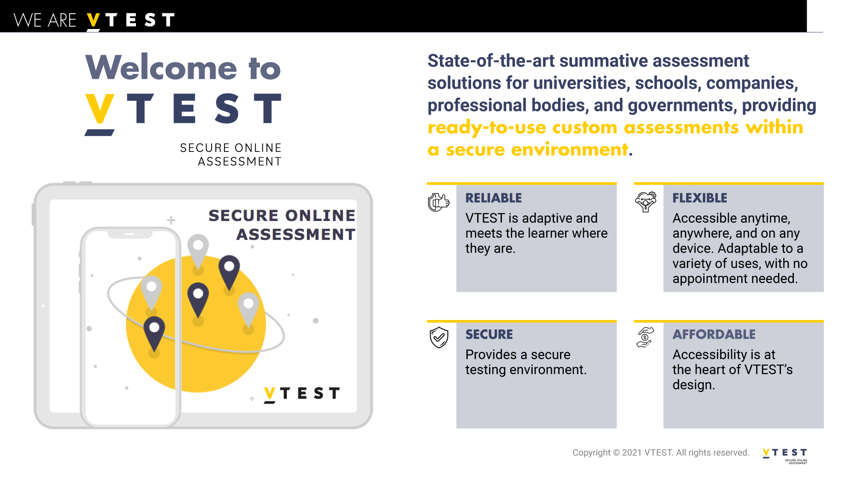

Slide 26
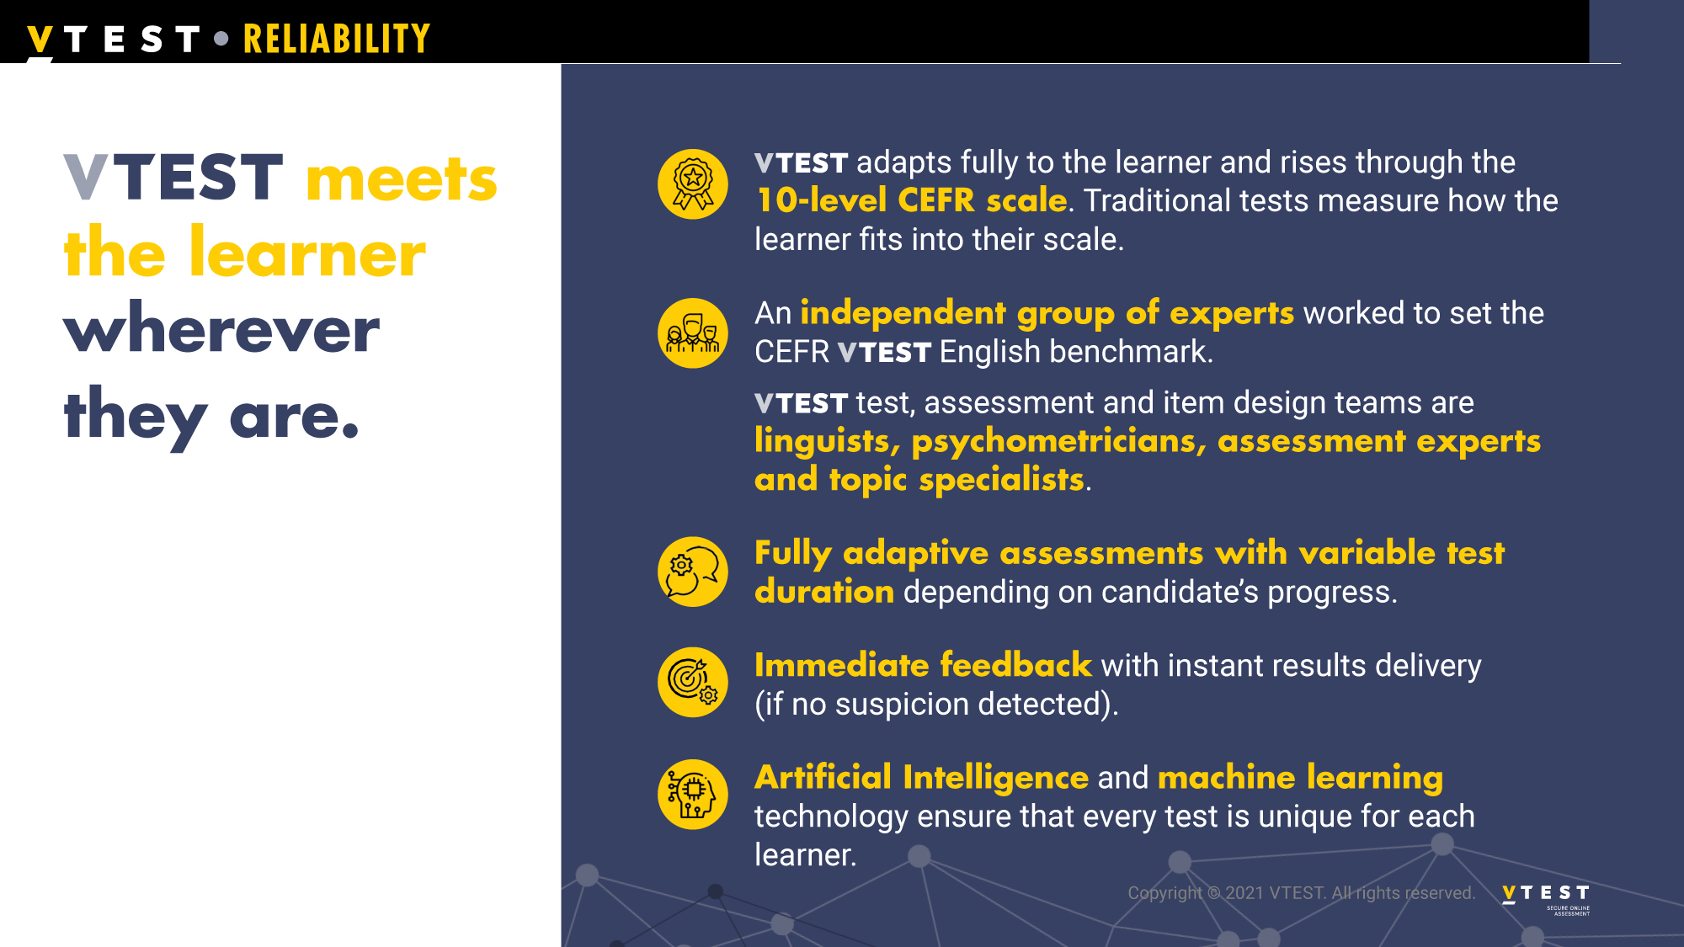

Slide 27
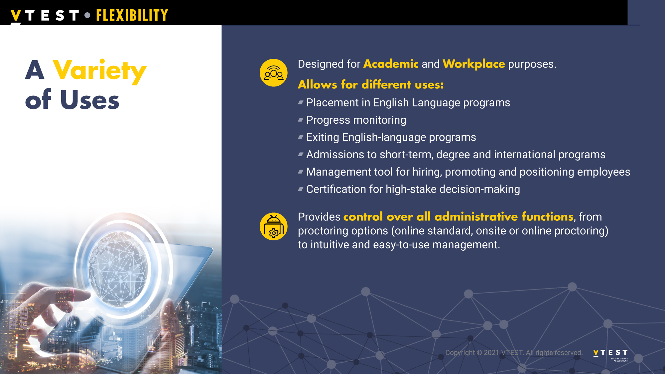

Slide 28
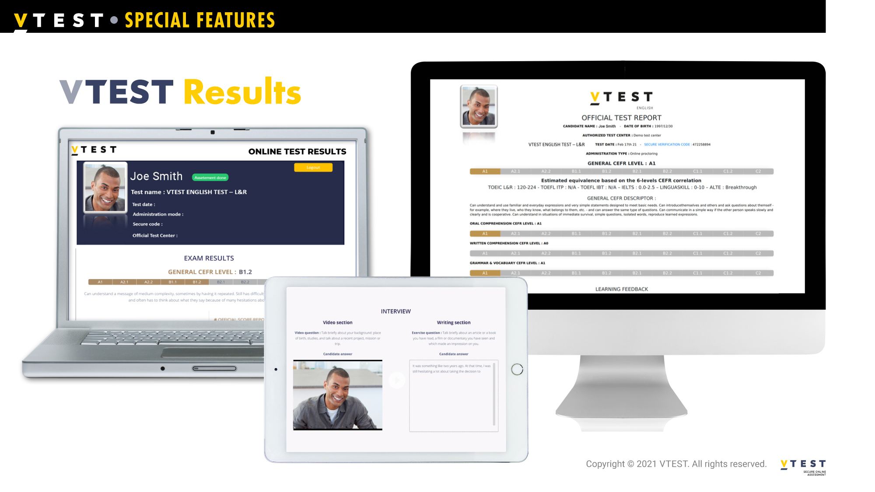
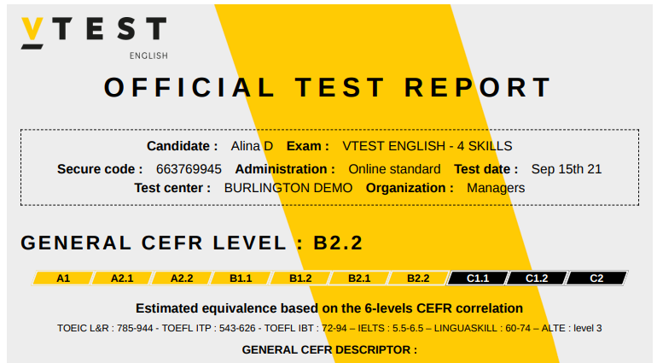
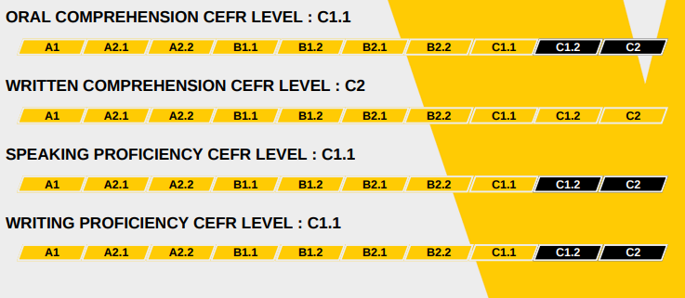
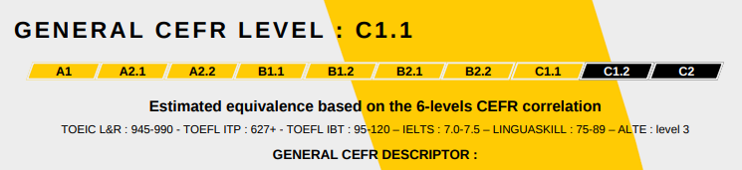
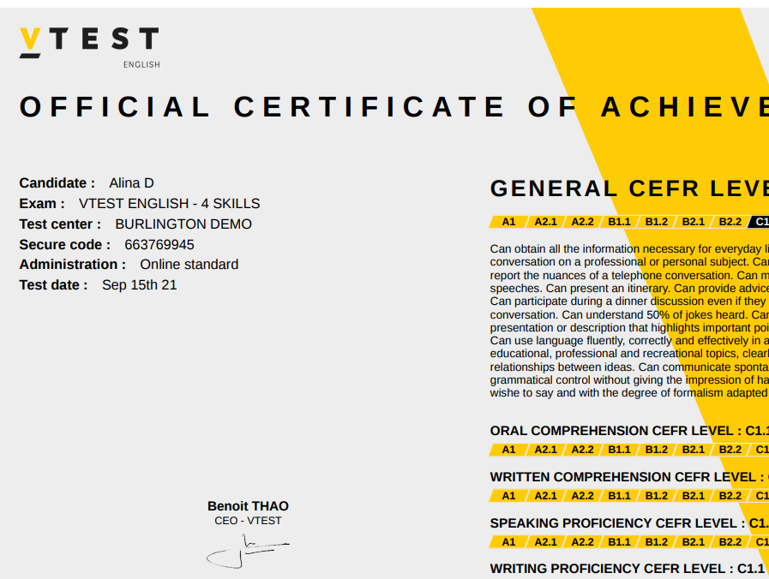

Slide 29
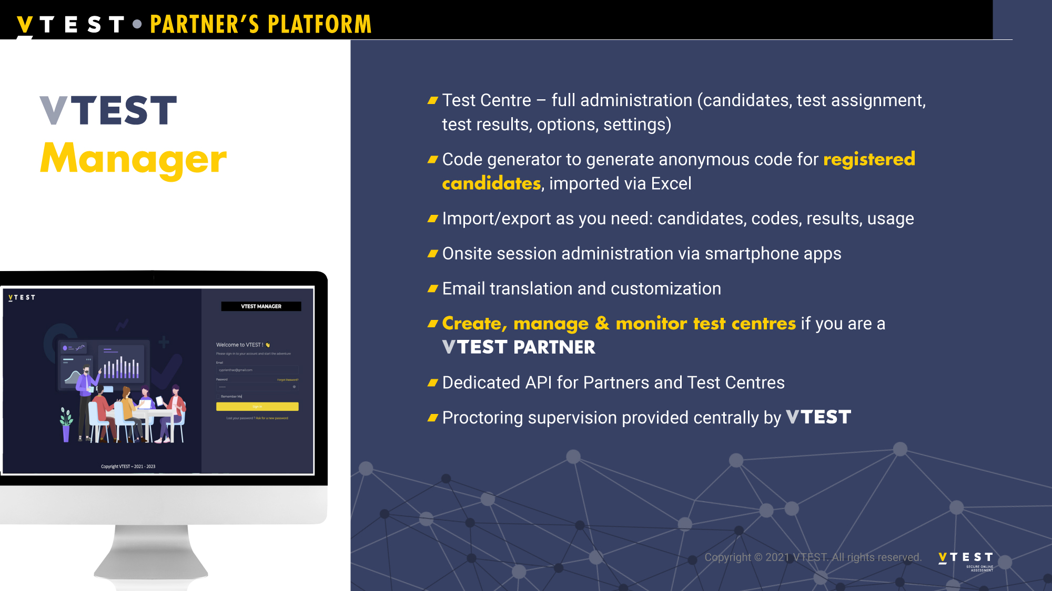

Slide 30
EDUSYNCH

Slide 31

EduSynch
Adaptive test, fully online, responsive
Test results are mapped to CEFR
Tests validated for reliability and efficacy
Whitelabel platform can be fully branded for the ACI
Students access the testing environment through a secure identification code
Full admin dashboard available for the ACI
License management done by ACI
Licenses can be purchased by ACI or individually by prospects, students, faculty or staff
Watch the 2-Skills test demo
Access the EduSynch Exam - CEFR Efficacy Study
Access the EduSynch Exam – CEFR Reliability and Validity Study

Slide 32
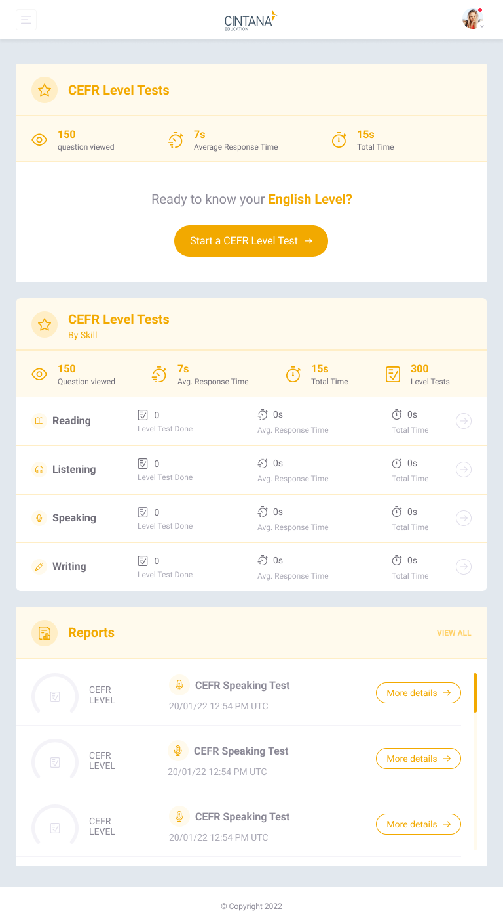
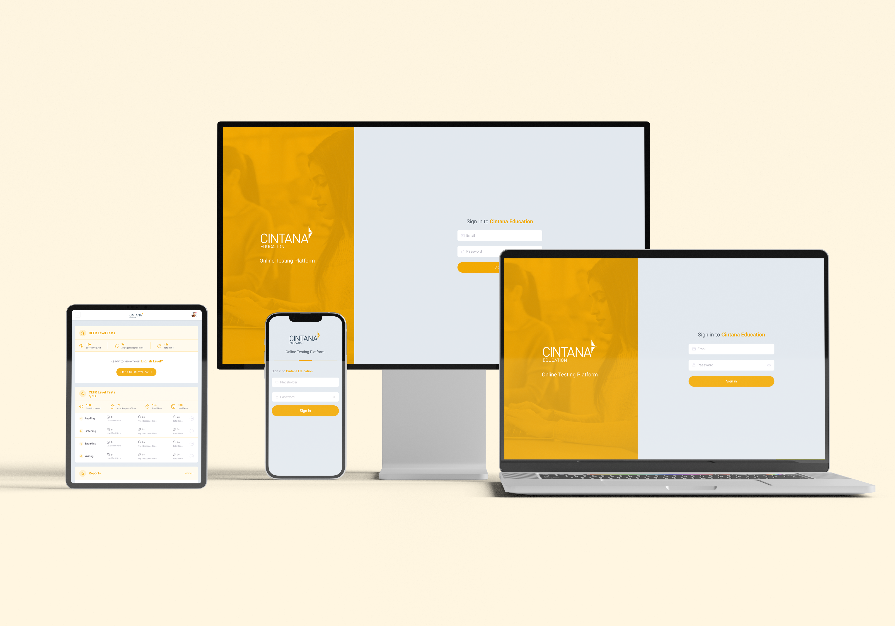

Slide 33
EXTEMPORE

Slide 34

Extempore
2-skills or 4-skills test can be created by ACIs based on Extempore library of test items
Language experts available to support ACIs in developing tests and for faculty training in building and administering tests
Whitelabel platform can be fully branded for the ACI
Full admin dashboard available for the ACI
Licenses can be purchased by ACI or individually by prospects, students, faculty or staff
Access the flyer in English
Access the flyer in Spanish

Slide 35
Faculty Training

Slide 36
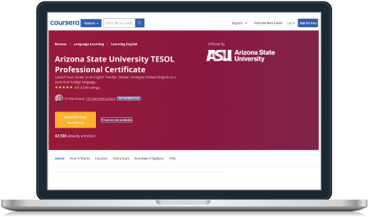
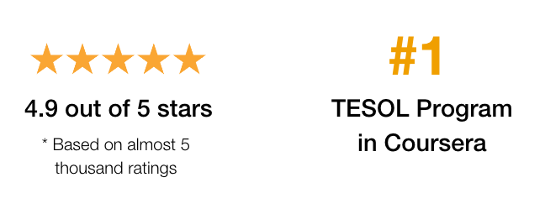
Arizona State University TESOL Professional Certificate
The first and most accessible completely online TESOL Certification program provided by a major American university
Designed for anyone who wants to teach English anywhere in the world
Designed in compliance with the standards outlined by the TESOL International Association for TESOL Certificate Programs

Slide 37
Learning Outcomes
Participants will:
Be able to master modern communicative techniques for engaging students in multiple English language learning environments
Recognize, identify, and use language acquisition theories and principles to develop sound lesson plans
Deliver lesson plans using interactive and engaging methods
Understand ways to motivate and properly engage students in an online and/or blended classroom.

Slide 38
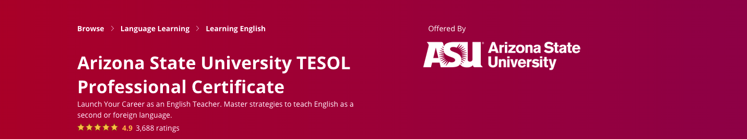
Courses
Teach English Now! Part 1
Foundational Principles | Theories of Second Language Acquisition | Lesson Design and Assessment | Capstone Project 1
Teach English Now! Part 2
Second Language Reading, Writing, and Grammar | Second Language Listening, Speaking, and Pronunciation | Technology Enriched Teaching | Capstone Project 2

Slide 39



Program Design
Coursework in Coursera
Live Zoom Sessions
Earn an International Certificate
Networking
8 courses: 100% online, self-paced
Peer collaboration & networking
Hands-on Practice
Certification
Specialization 1: Courses 1-4
  3 Courses + 1 Capstone
Specialization 2: Courses 5-8
  3 Courses + 1 Capstone
Run by ASU and moderated by Cintana
Engage with colleagues
Discuss about course content
Share best practices
Announcements and deadlines
Moderated by Cintana
Live sessions
Hands-on practice
Exchange ideas for classroom applications
Discuss and reflect on teaching practices
Moderated by Cintana
8 Coursera course certificates (1 per course)
2 Specialization certificates (Courses 1-4 and Courses 5-8)
ASU TESOL Certificate with 150 hours of instruction

Slide 40

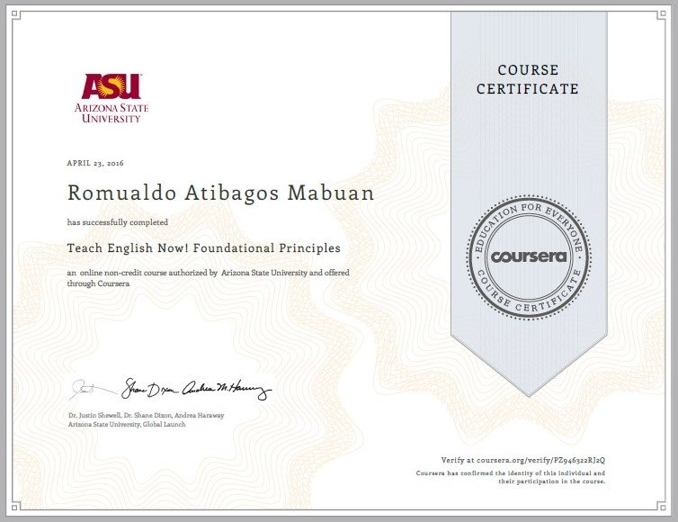
Certification
ASU TESOL Certificate
with 150 hours of instruction
Coursera Course Certificates

Slide 41

English Program Best Practices & Training
The English Program Best Practices & Training showcases the teaching philosophy of the Global Digital English Courses, implementation models available, and the teaching and learning best practices for an effective implementation of the curriculum in the classroom.
Learning outcomes:
Understand the teaching philosophy of the Global Digital English courses
Analyze how productive and receptive skills can be taught and practiced in the Global Digital English courses
Analyze teaching practices in fully online, blended and face-to-face course offerings
Create lesson plans adapted to your local English program
Evaluate metrics of success for your local program
Notes:
https://lms.cintana.com/courses/65

Slide 42
English Program Best Practices & Training
The training is divided into two parts: an online portion and a synchronous workshop.
Part 1: Online, self-paced, provided by Cintana on Canvas
Understand the teaching philosophy of the Global Digital English Courses and how the Flipped Classroom Model is used
Watch a demonstration class conducted by ASU Global Launch teacher trainers, previously recorded
Reflect on the demonstration class perceptions
Identify challenges, needs, and opportunities for your teaching practice
Access the syllabi, facilitator guidebooks, and other supplemental materials for the GDE courses
Part 2: Workshop, synchronous, provided by the ACI
Discuss implementation models of the Global Digital English Courses
Discuss perceptions from the demonstration class as well as challenges, needs, and opportunities
Create lesson plans based on the Flipped Classroom Model
Evaluate metrics of success for the program
Notes:
https://lms.cintana.com/courses/65

Slide 43
Interested? Contact us.
For more information:
Diego Garcia
Sr. Director, Products & Services
dgarcia@cintana.com
Carolina Zuppardi
Director, Products & Services
czuppardi@cintana.com

